Slide 1
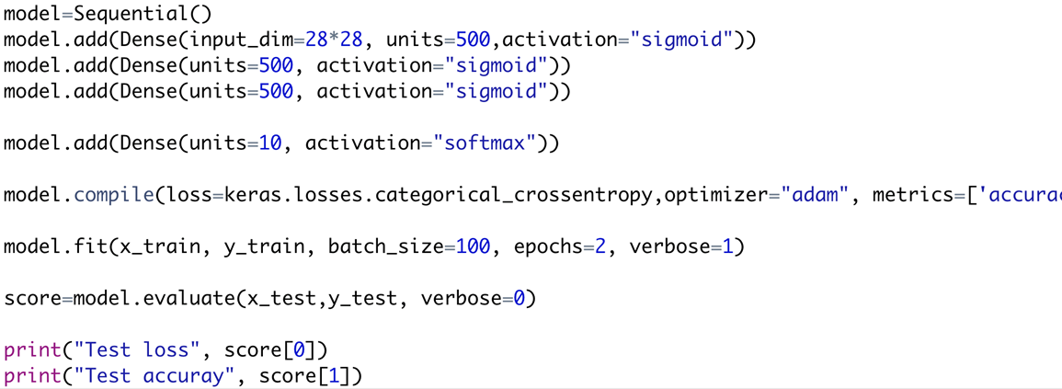
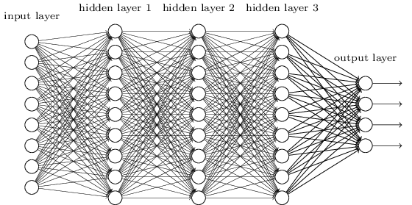
Smaller Network: CNN

Slide 2
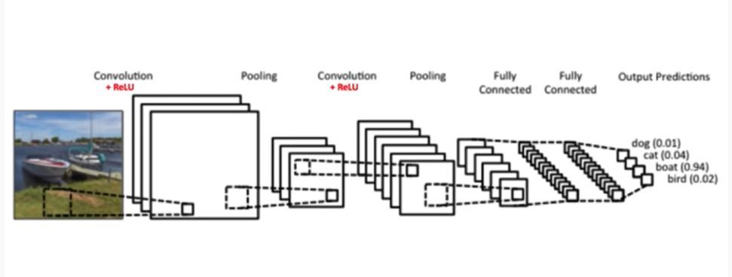
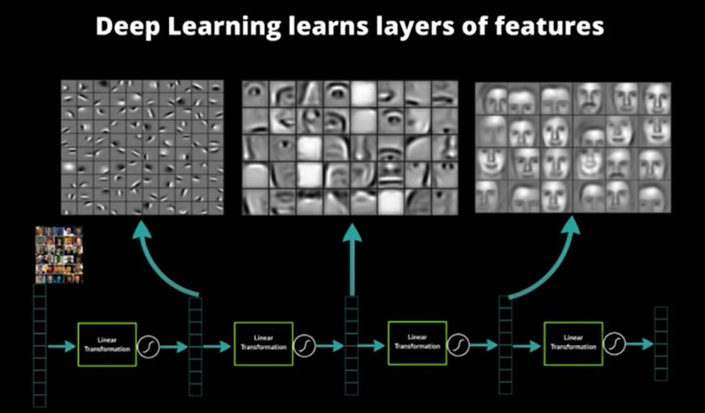
CNN Network

Slide 3
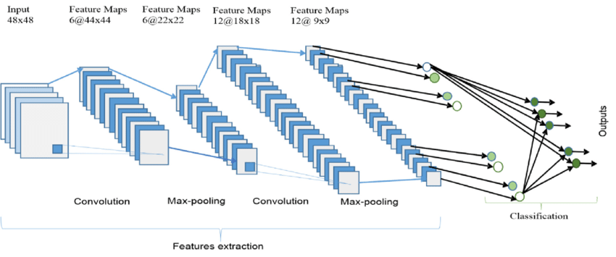
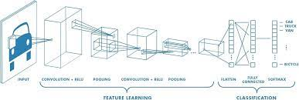

Slide 4
Deep Learning
Residual Network and other CNN variants

Slide 5
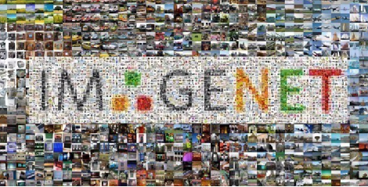
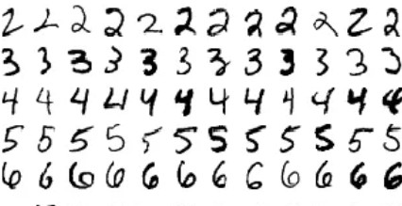
ImageNet (2010)
Images | Color images with nature objects | Gray image for hand-written digits
Size | 469 x 387 | 28 x 28
#examples | 1.2 M | 60 K
# classes | 1,000 | 10
15

Slide 6
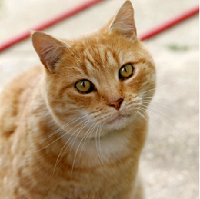
AlexNet
AlexNet won ImageNet competition in 2012
Deeper and bigger LeNet
Key modifications
Dropout (regularization)
ReLu (training)
MaxPooling
Paradigm shift for computer vision
SVM
Softmax regression
Manually engineered
Features learned by a CNN
16
Alex Krizhevsky, Ilya Sutskever, Geoffrey E Hinton. Imagenet classification with deep convolutional neural networks. 2012

Slide 7
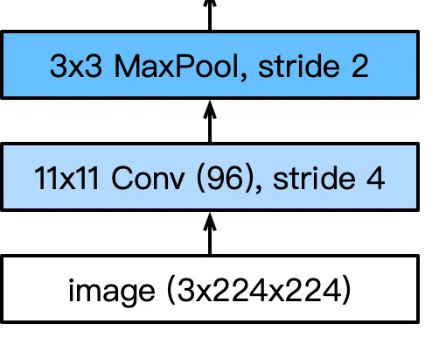
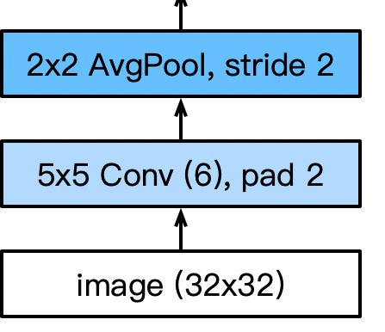
AlexNet Architecture
AlexNet
LeNet
Larger pool size, change to max pooling
Larger kernel size, stride because of the increased image size, and more output channels.

Slide 8
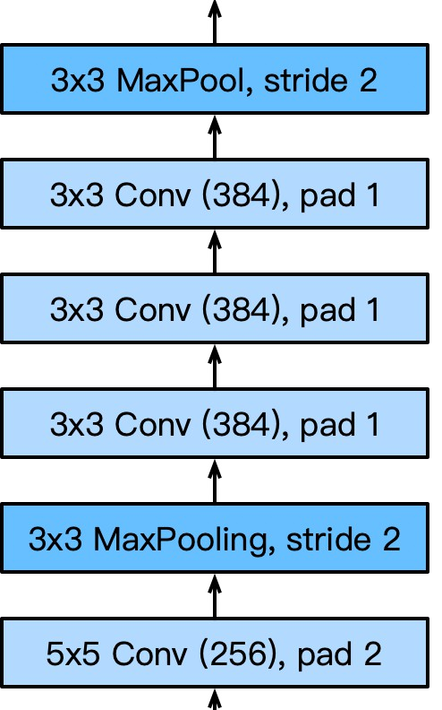
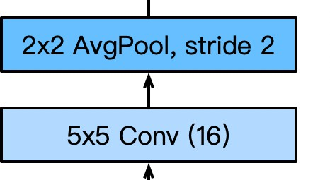
AlexNet Architecture
AlexNet
LeNet
3 additional
convolutional layers
More output channels.

Slide 9
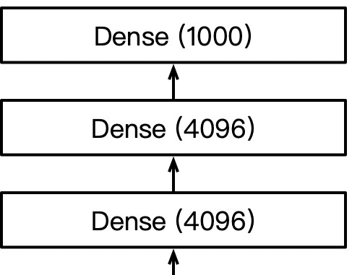
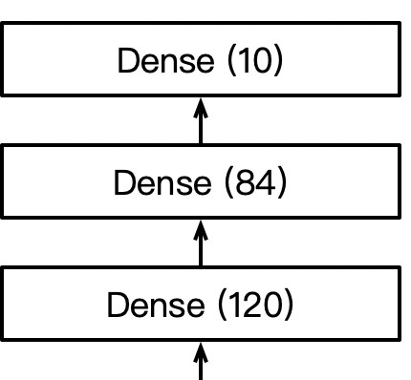
AlexNet Architecture
AlexNet
LeNet
1000 classes output
Increase hidden size
from 120 to 4096

Slide 10
Comparing CNN, AlexNet, and ResNet in Keras
Evolution of Depth, Optimization, and Transfer Learning??

Slide 11
Simple CNN
- Layers: 2 conv + pooling + 2 dense
- Params: ~0.2M
- Performance: ~60% on CIFAR-10
- Strength: Fast, simple
- Limitation: Underfits complex data

Slide 12
AlexNet (2012)
- 5 conv + 3 dense layers (~60M params originally)
- Introduced ReLU, dropout, augmentation
- Deeper than CNN but unstable without normalization

Slide 13
ResNet (2015)
- 50+ layers with skip connections (y = F(x) + x)
- Solves vanishing gradient & degradation
- Enables very deep, trainable networks

Slide 14
Code Recap
- Dataset: CIFAR-10
- Models: Simple CNN, AlexNet-like, ResNet50
- Same optimizer and preprocessing
- Metric: Validation accuracy/loss

Slide 15
Training Results: Accuracy
Interpretation:
- Simple CNN: Low, stable
- AlexNet-like: Improves but overfits
- ResNet50: High, stable — best generalization

Slide 16
Training Results: Loss
Interpretation:
- Simple CNN: Underfits (high bias)
- AlexNet-like: Overfits (high variance)
- ResNet: Balanced

Slide 17
Vanishing Gradients
Gradients shrink as they propagate backward.
→ Early layers stop learning.
→ Deeper networks may degrade without residuals.

Slide 18
Skip Connections
Equation: y = F(x) + x
Backprop: ∂L/∂x = ∂L/∂y * (1 + ∂F/∂x)
Ensures gradient always has a direct path → stable training.

Slide 19
Transfer Learning
- Uses pretrained weights (ImageNet → CIFAR)
- Benefits: Faster, more accurate, less overfitting
- Freeze base, train small dense head
Instead of training a deep neural network from scratch—which requires millions of labeled images and extensive computation—you can leverage a pretrained model (e.g., ResNet50 trained on ImageNet) and transfer its learned features to a new, smaller dataset (e.g., classifying medical images, plant species, or custom objects).

Slide 20
Step-by-Step Explanation
Pretrained Model (Source Domain)
Use a deep CNN like ResNet50, which has already learned to recognize general image features (edges, shapes, textures) from ImageNet (over 1 million labeled images across 1000 classes).
Target Domain
Suppose you have a dataset of X-ray chest images for classifying Normal vs Pneumonia (only a few thousand samples).
Training a deep CNN from scratch would cause overfitting and require huge resources.
Transfer Learning Strategy
Load pretrained ResNet50 with weights from ImageNet.
Remove the top (fully connected) layer, which outputs 1000 ImageNet classes.
Freeze the convolutional base layers to retain learned low-level features.
Add new fully connected layers suitable for your target classes (e.g., 2 neurons for binary classification).
Train only the new top layers, or fine-tune a few upper convolutional layers.

Slide 21
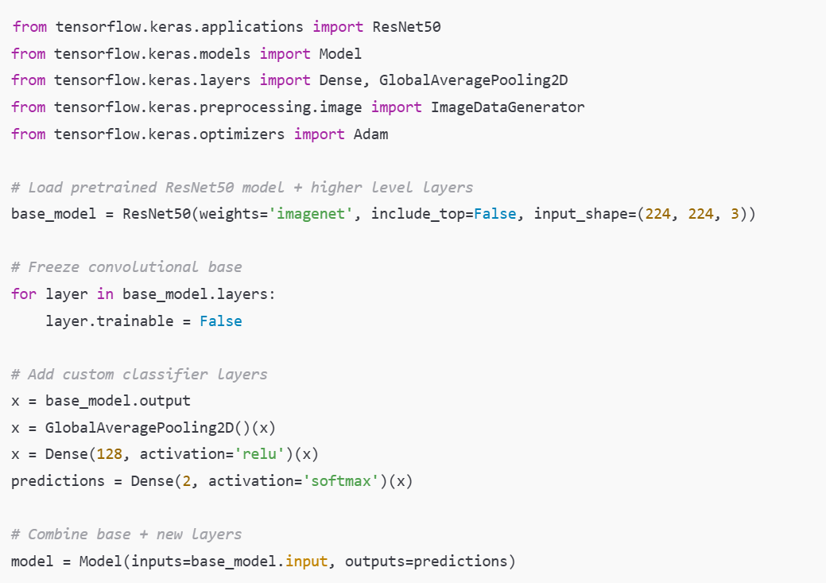

Slide 22
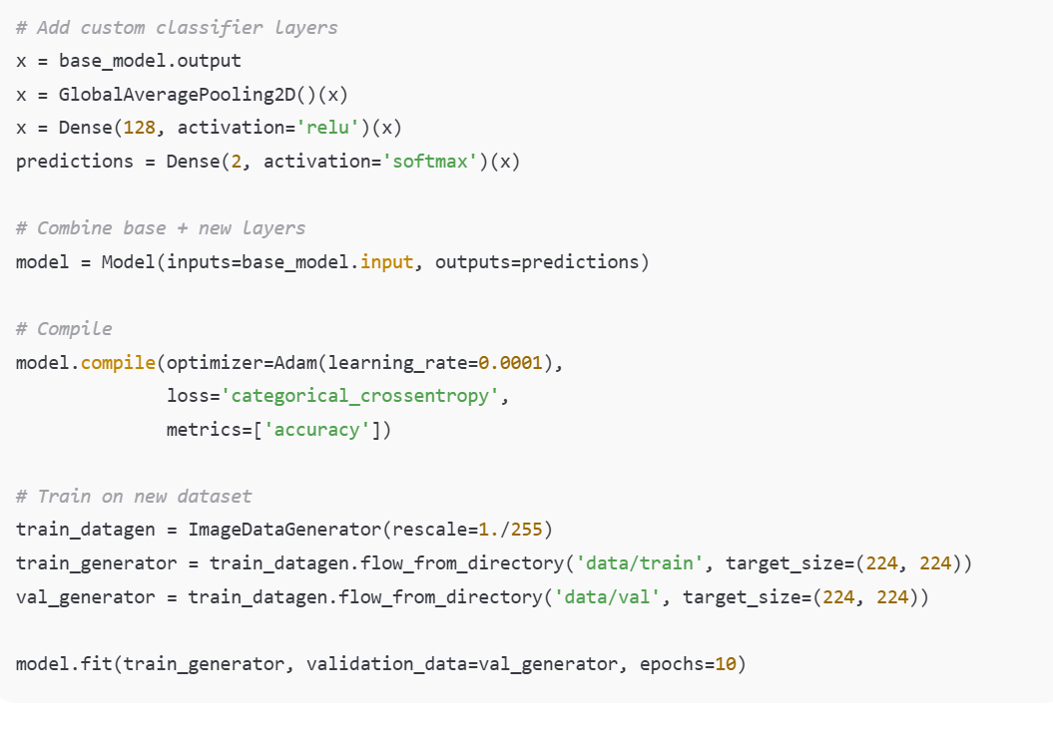

Slide 23
Overfitting & Overparameterization
Simple CNN: Underfits (~0.2M params)
AlexNet-like: Overfits (~10M)
ResNet50: Generalizes (~25M, pretrained)

Slide 24
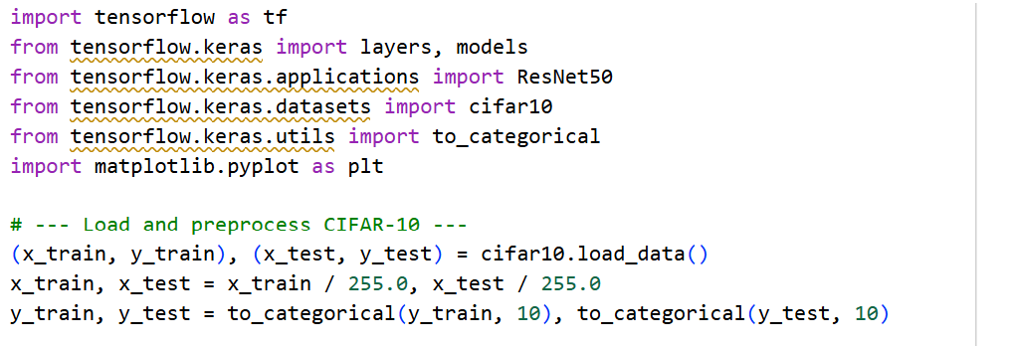
Keras example

Slide 25
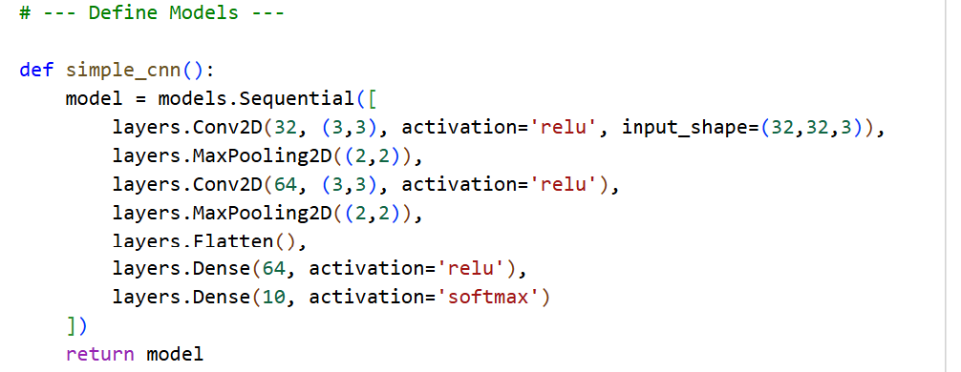

Slide 26
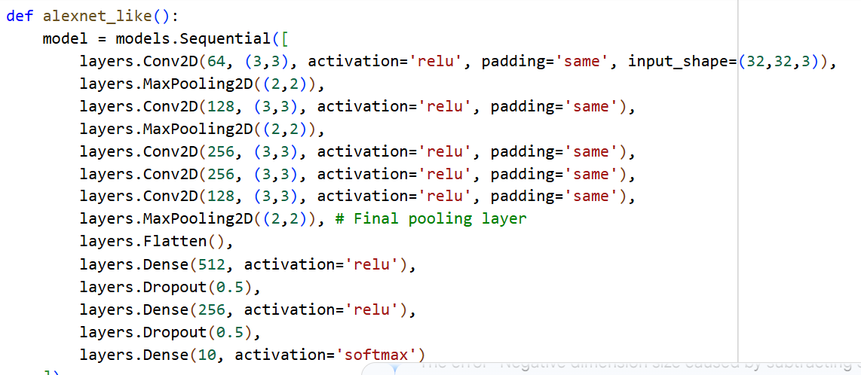


Slide 27
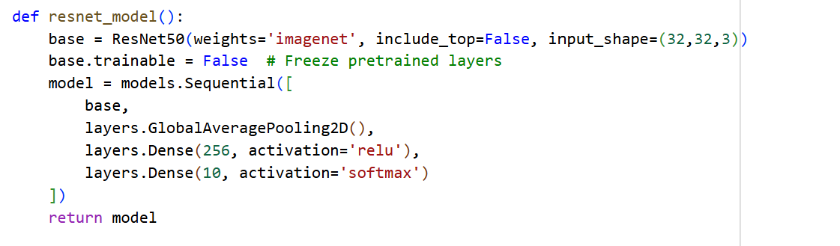

Slide 28
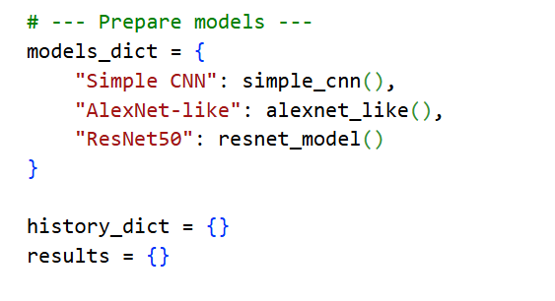
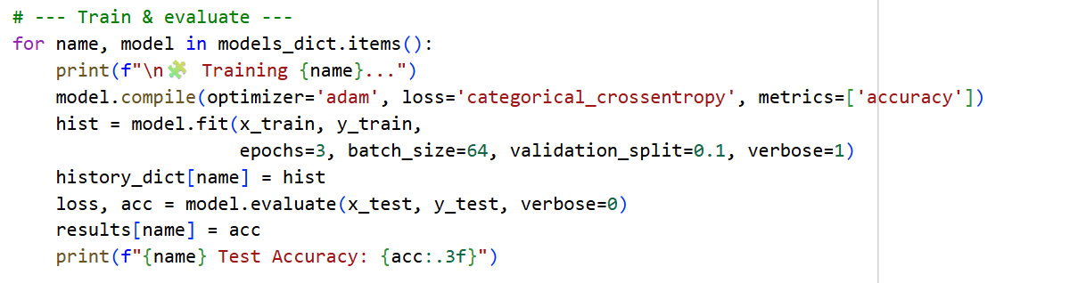

Slide 29
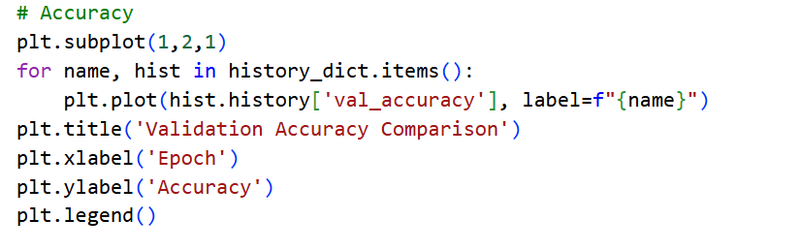
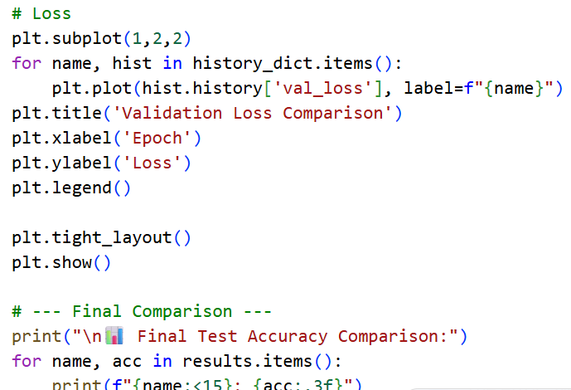

Slide 30
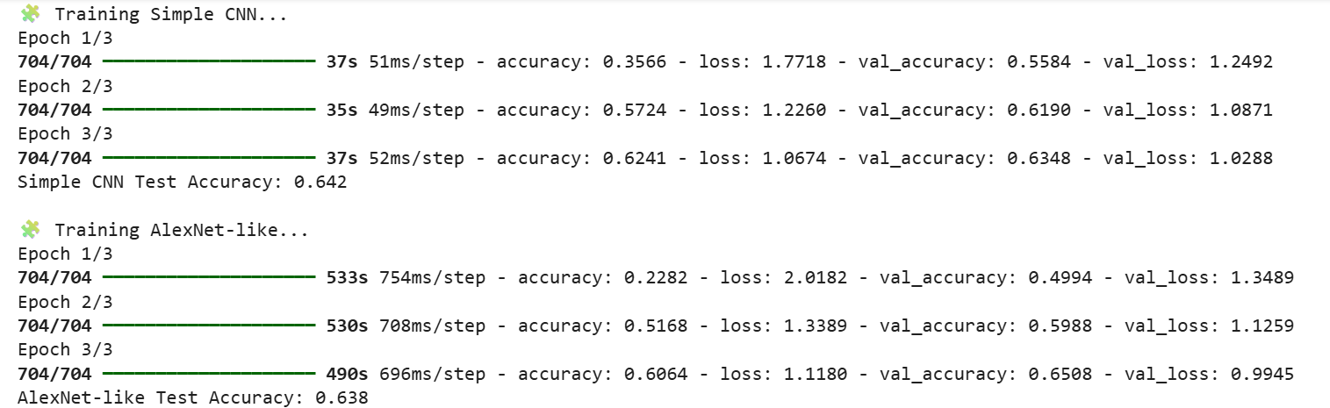
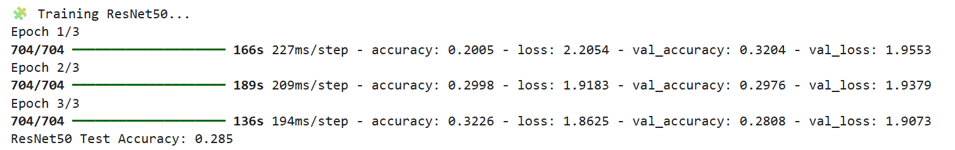

Slide 31
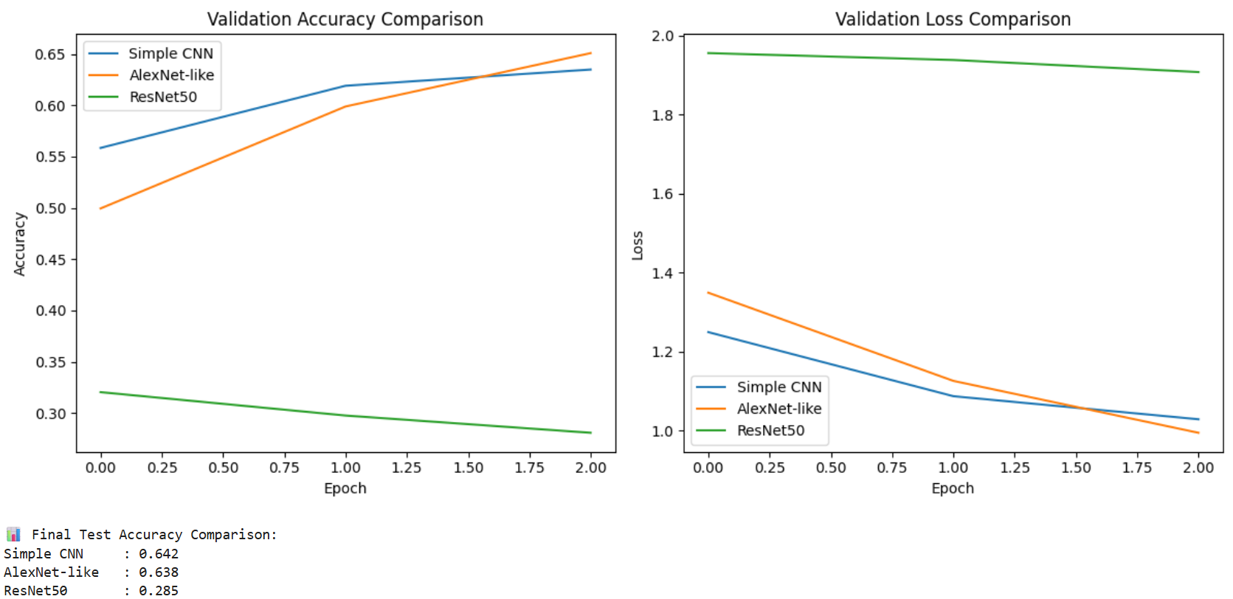

Slide 32
Model | Depth | Parameters | Expected Accuracy (1 Epoch) | Notes
Simple CNN | Shallow (2 conv blocks) | ~0.2M | ~60% | Fast, underfits
AlexNet-like | Deep (5 conv + 2 FC) | ~10M | ~70% | Larger receptive fields
ResNet50 | 50 layers | ~25M | ~80% | Skip connections help generalization

Slide 33
1. Vanishing Gradients and Deep Networks
As neural networks become deeper (many stacked layers), the gradients used during backpropagation tend to become very small in the early layers.When this happens, earlier layers learn very slowly or not at all — this is known as the vanishing gradient
Simple CNN: Only 2–3 convolutional layers — shallow, so gradients flow easily.
AlexNet-like: Deeper (5 conv + 2 dense) — prone to vanishing gradients if not designed carefully.
ResNet50: Introduces skip (residual) connections, which bypass one or more layers and allow gradients to flow directly back to earlier layers.

Slide 34
2. Transfer Learning (ResNet50)
Transfer learning uses weights pre-trained on a large dataset (like ImageNet) and applies them to a smaller or different dataset (like CIFAR-10). The model already knows general visual patterns (edges, shapes, textures), so it only needs to adapt to new classes.
The ResNet50 base is pre-trained on ImageNet.You freeze its convolutional layers (so they’re not retrained).You add a small dense head to classify CIFAR-10.
🔹 Benefits:
Faster convergence (learns in fewer epochs).
Higher accuracy with limited data.
Less overfitting, since the convolutional base is already generalized.

Slide 35
3. Overparameterization and Overfitting
More parameters (weights) mean more capacity to learn complex patterns, but also a higher risk of memorizing the training data — that’s overfitting.
Simple CNN: Small parameter count (~200K) — underfits complex data.
AlexNet-like: Large (~10M) — may overfit small datasets like CIFAR-10.
ResNet50: Very large (~25M) but benefits from pretraining and regularization.

Slide 36
4. Skip Connections and Model Depth
Deeper networks can theoretically represent more complex functions.However, before ResNet, adding layers degraded performance because optimization became unstable.
ResNet’s Innovation:Residual learning allows 50, 101, or even 152 layers to be trained effectively.The residual path ensures that even if deeper layers fail to learn something useful, the model still performs as if it were shallower — avoiding degradation.

Slide 37
5. Efficiency Trade-offs
Model | Accuracy | Training Speed | Memory Use | Discussion
Simple CNN | Low (~60%) | Very fast | Low | Good baseline; underfits
AlexNet-like | Medium (~70%) | Moderate | High | Heavy, overfits small data
ResNet50 (Transfer) | High (~80–85%) | Fast (frozen base) | Medium | Most efficient in accuracy/time ratio
Should we always use the deepest model?→ Not necessarily. For small datasets, a simpler CNN might generalize better.
Is transfer learning always better?→ Only if the source and target domains are related. (e.g., ImageNet → CIFAR works, but ImageNet → Medical MRI might not.)

Slide 38
6. Interpreting Training Curves
Show validation accuracy/loss plots:
Simple CNN: slow improvement, low ceiling.
high bias (underfits)
AlexNet-like: high training accuracy but validation plateaus — overfitting.
high variance (overfits)
ResNet50: high, stable validation accuracy — good generalization.
balanced (good bias–variance trade-off)

Slide 39
Why doesn’t adding more layers always increase performance?
Because deeper networks are harder to optimize and can suffer from vanishing/exploding gradients, degradation, or overfitting.
Gradients vanish as they propagate backward, especially through many non-linear activations.
Deeper networks can degrade, meaning training accuracy itself worsens — not because of overfitting, but because the optimization landscape becomes unstable.
Overfitting can also occur when the model memorizes training data but fails to generalize.

Slide 40
What happens if we unfreeze all layers of ResNet50 on CIFAR-10?
The model will likely overfit and train slowly, possibly with little improvement in accuracy.
ResNet50 is pre-trained on ImageNet (1.2M images, 1000 classes) — its convolutional filters are tuned to large, high-resolution, natural images.
CIFAR-10 is small and low-resolution (32×32).
If you unfreeze all layers:
You allow the model to update the pre-trained weights, but since CIFAR-10 is small, it doesn’t have enough data to re-learn good general features.
The optimizer will disturb the well-learned low-level filters, leading to catastrophic forgetting.
Training time and memory usage increase significantly.
Correct Strategy:
Freeze the convolutional base (feature extractor) initially.
Unfreeze the top few blocks only if you have enough data or want fine-tuning.

Slide 41
How do skip connections improve gradient flow mathematically?
They allow gradients to bypass nonlinear transformations, ensuring that the gradient can flow directly to earlier layers.
Use an alternate route:
preserves gradient magnitude during backpropagation.
Enables stable training of very deep networks (e.g., 50–150+ layers).
Prevents degradation — deeper models perform at least as well as shallower ones.

Slide 42
Would AlexNet perform better with Batch Normalization?
Yes — adding Batch Normalization (BN) layers would likely improve convergence, stability, and accuracy.
BN after each convolutional layer: :
Stabilizes gradient flow.(Training becomes smoother and faster.)
Allows higher learning rates.(Test accuracy improves (especially on small datasets like CIFAR-10).
Acts as a regularizer (reduces overfitting)=> Dropout can often be reduced because BN provides implicit regularization.

Slide 43
When might transfer learning not be helpful?
When the source domain and target domain are too different — the learned features are not transferable.
Why It Fails:
Early convolutional layers capture generic features (edges, gradients).
Later layers capture domain-specific features (animal faces, textures, etc.).
If domains differ drastically, these learned representations are not useful, and might even hurt performance (negative transfer).
Solution:
Use self-supervised pretraining (e.g., SimCLR, MAE) on unlabeled data from your target domain.
Train from scratch if the dataset is large enough.

Slide 44
Summary
Question | Key Concept | Core Answer
Why doesn’t more depth always help? | Optimization issues | Deep networks may degrade due to vanishing gradients; ResNet fixes it.
What if we unfreeze all ResNet layers? | Fine-tuning & overfitting | Overfits small data; better to freeze or partially fine-tune.
How do skip connections help? | Gradient flow | Preserve identity gradient; prevent vanishing.
AlexNet + BN? | Normalization | Yes — improves stability and accuracy.
When not to use transfer learning? | Domain mismatch | When pretraining domain differs from target domain.

Slide 45
Questions
1. Why doesn’t adding layers always help? Deep networks degrade w/o skip connections
2. What if we unfreeze all ResNet layers? Overfits small data
3. How do skip connections help? Skip connections preserve gradient flow
4. Would AlexNet improve with BatchNorm? BN stabilizes & regularizes
5. When might transfer learning fail? Fails with domain mismatch

Slide 46
More Tricks
Change activation function from sigmoid to ReLu (no more vanishing gradient)
Add a dropout layer after two hidden FFN layers (better robustness / regularization)
Data augmentation

Slide 47
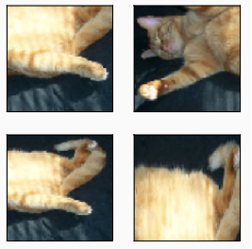
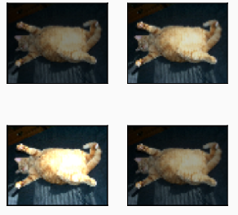
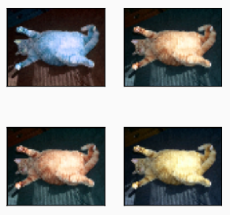
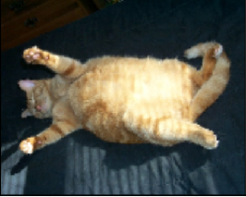
Data Augmentation
Create additional training data with existing data

Slide 48
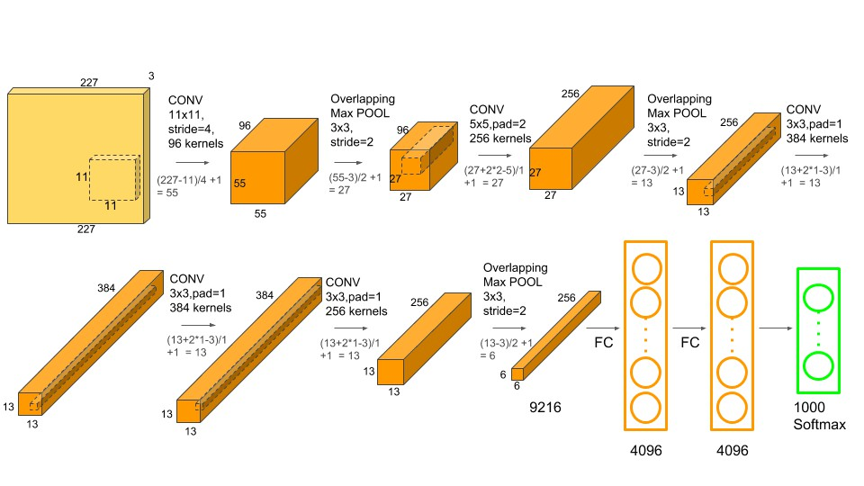
AlexNet

Slide 49
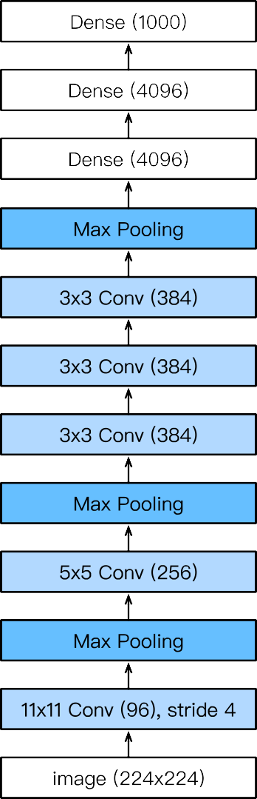
Complexity
 | #parameters |  | FLOP
 | AlexNet | LeNet | AlexNet | LeNet
Conv1 | 35K | 150 | 101M | 1.2M
Conv2 | 614K | 2.4K | 415M | 2.4M
Conv3-5 | 3M |  | 445M
Dense1 | 26M | 0.48M | 26M | 0.48M
Dense2 | 16M | 0.1M | 16M | 0.1M
Total | 46M | 0.6M | 1G | 4M
Increase | 11x | 1x | 250x | 1x
FLOPS, or floating-point operations per second, is a metric for computer performance that quantifies the number of floating-point calculations a system can perform in one second.
25

Slide 50
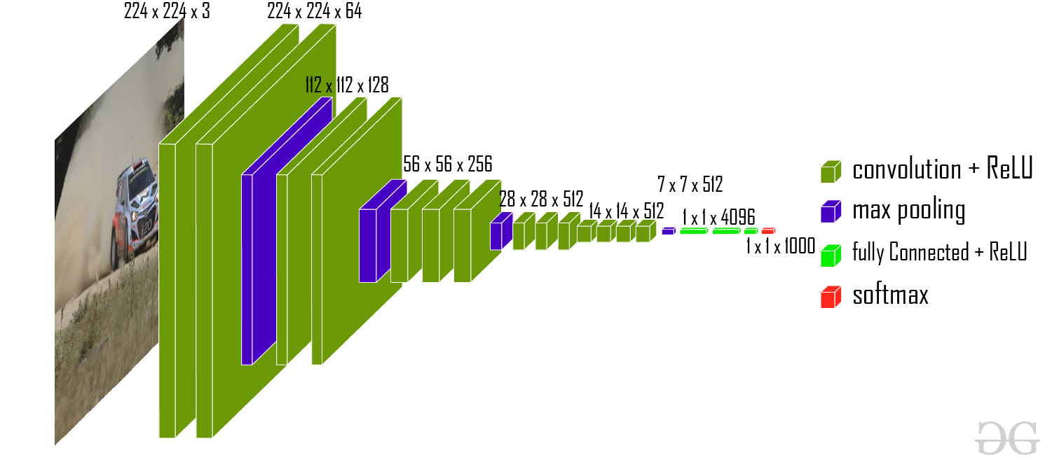
VGG
Visual Geometry Group
model achieves 92.7% top-5 test accuracy on the ImageNet dataset which contains 14 million images belonging to 1000 classes

Slide 51
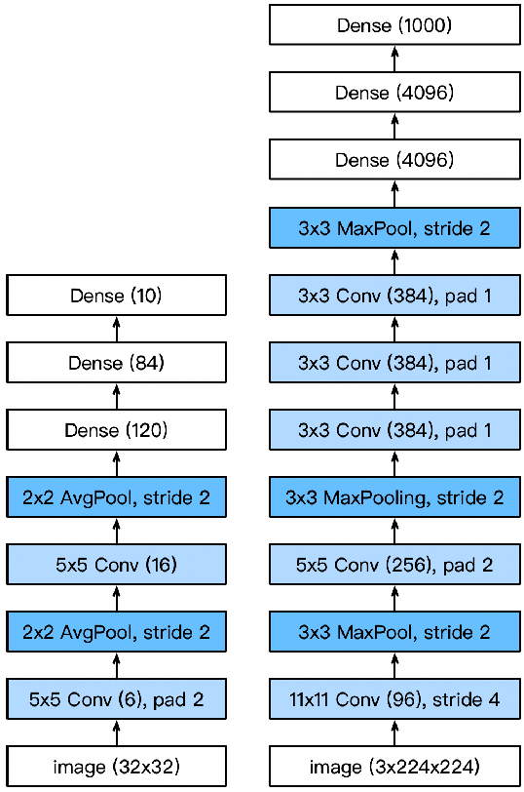
VGG
AlexNet is deeper and bigger than LeNet to get performance
Go even bigger & deeper?
Options
More dense layers (too expensive)
More convolutions
Group into blocks

Slide 52
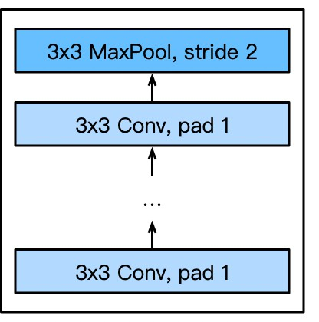
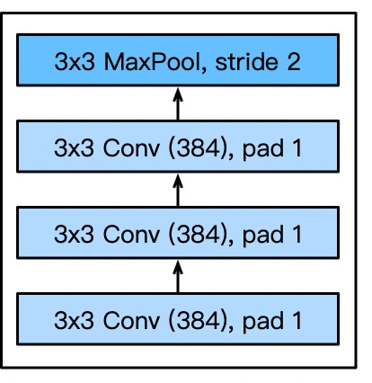
VGG Blocks
Deeper vs. wider?
5x5 convolutions
3x3 convolutions (more) ^{VGG block}
Deep & narrow better
VGG block
3x3 convolutions (pad 1)
(n layers, m channels)
2x2 max-pooling (stride 2)
Part of AlexNet

Slide 53
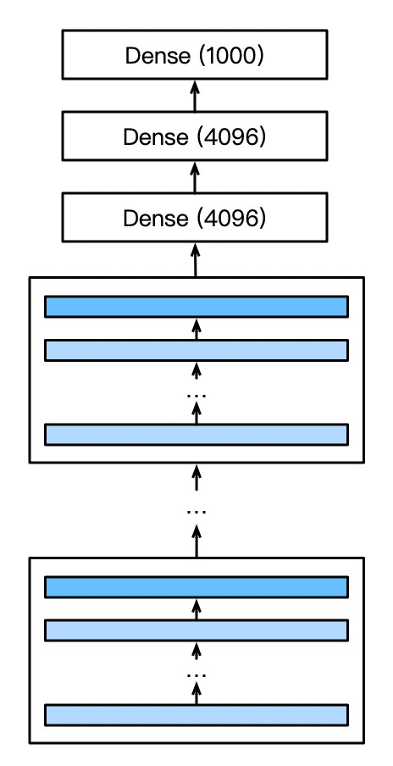
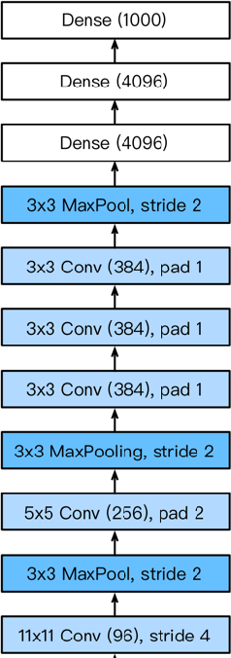
VGG Architecture
VGG
AlexNet
Multiple VGG blocks followed by dense layers
Vary the repeating number to get different architectures, such as VGG-16, VGG-19, …

Slide 54
Going Deeper
LeNet (1995)
2 convolution + pooling layers
2 hidden dense layers
AlexNet
Bigger and deeper LeNet
ReLu, Dropout, preprocessing
VGG
Bigger and deeper AlexNet (repeated VGG blocks)

Slide 55
Residual Networks
A pre-trained Convolutional Neural Network for image classification and computer vision.
Best paper CVPR 2016
Types of ResNets:
1.ResNet18, 2. ResNet34, 3.ResNet50, 4. ResNet101, 5. ResNet152
Suffix number refers to the number of layers used in their network architecture.

Slide 56
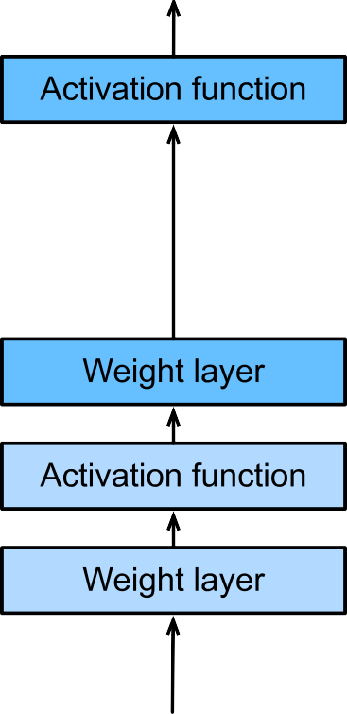
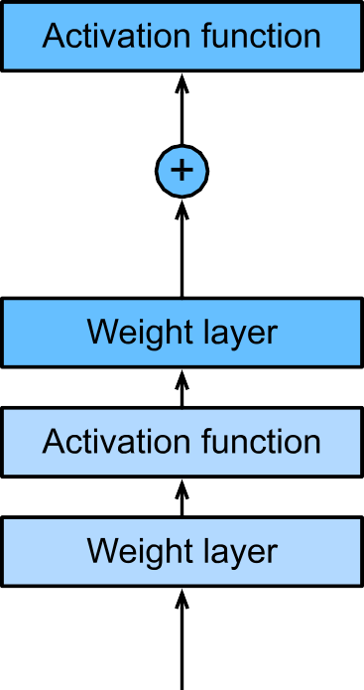



Residual Networks
Adding a layer changes function class
We want to add to
the function class
‘Taylor expansion'
style
f(x) = x + g(x)
parametrization
Residual block, the portion within the dotted-line box needs to learn the residual mapping g(x)=f(x)-x, making the identity mapping f(x)=x easier to learn.
Regular block the portion within the dotted-line box must directly learn the mapping
33
Kaiming He, Xiangyu Zhang, Shaoqing Ren, Jian Sun, Deep Residual Learning for Image Recognition. 2016

Slide 57
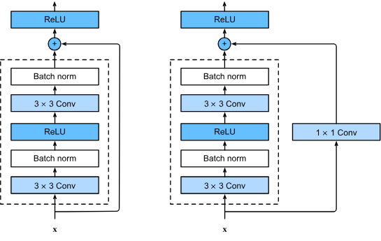
Residual Networks
This block includes a convolutional layer with a stride of (2, 2) to downsample the input, and a convolutional layer with a (1, 1) filter size to change the depth of the input to match the output.
Adjust channels and resolution by means of a 1x1 convolution before adding
Add the input to the output before applying the ReLU
1x1 convolutional layer to transform the input into the desired shape for the addition operation, if the number of channels has changed

Slide 58
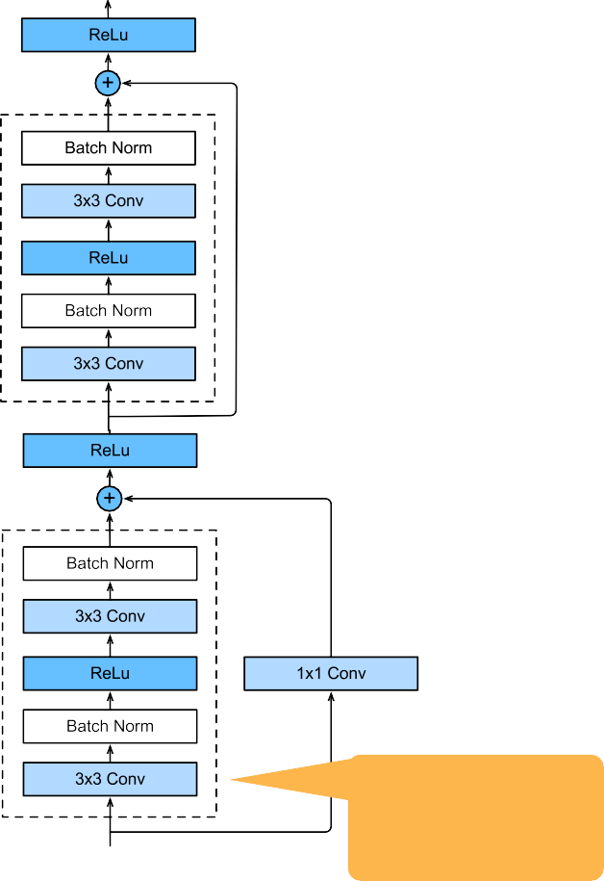
ResNet Module
Downsample per module (stride=2)
Enforce some nontrivial nonlinearity per module (via 1x1 convolution)
Stack up in blocks
Multiple
Stride 2

Slide 59
blk = nn.Sequential()
for i in range(num_residuals):
if i == 0 and not first_block: blk.add(Residual(num_channels,
use_1x1conv=True, strides=2))
else:
blk.add(Residual(num_channels))

Slide 60
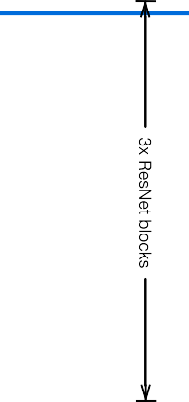
Putting it all together
Same block structure as e.g. VGG or GoogleNet
Residual connection to add to expressiveness
Pooling/stride for dimensionality reduction
Batch Normalization for capacity control
… train it at scale …

Slide 61
ResNext

Slide 62
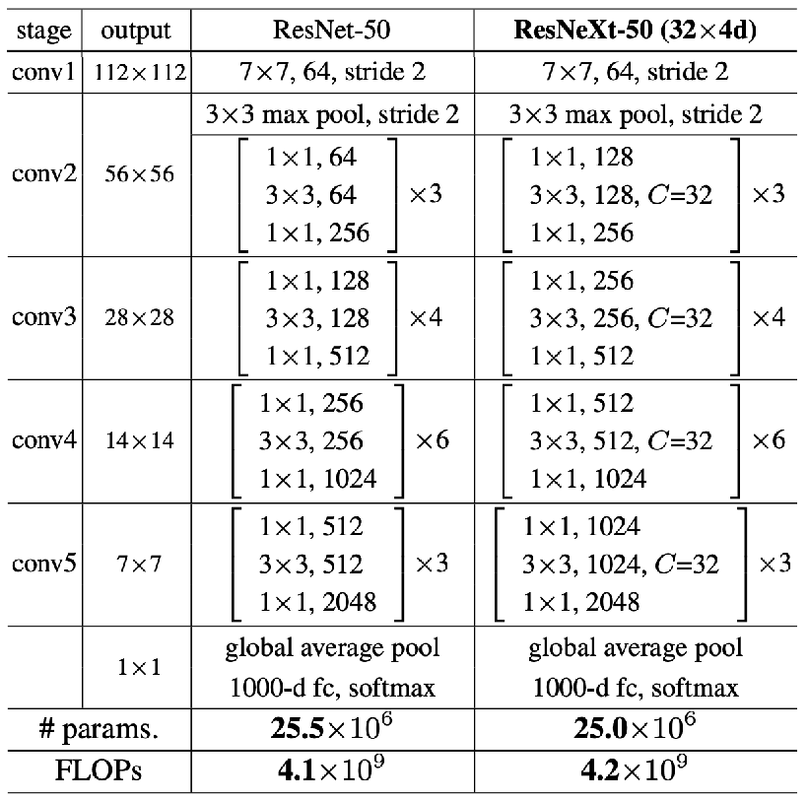
RexNext budget
Slice blocks into 32 sub-blocks
Can use more dimensions
Higher accuracy

Slide 63
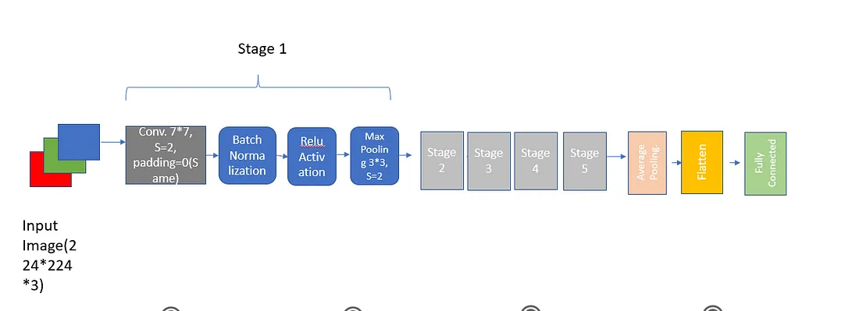
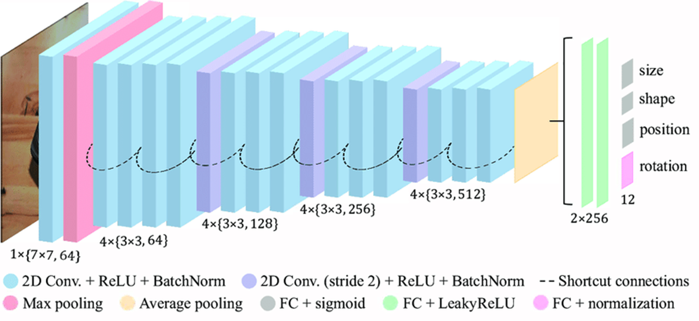
ResNet50 consists of 16 residual blocks, with each block consisting of several convolutional layers with residual connections.
The architecture also includes pooling layers, fully connected layers, and a softmax output layer for classification.

Slide 64
Stage 1:
First convolutional layer, which takes as input the raw image with dimensions (224, 224, 3) and outputs a feature map with dimensions (112, 112, 64).
This layer uses 64 filters, each with a kernel size of (7, 7) and a stride of (2, 2) to downsample the input image by a factor of 2 in both the width and height dimensions.
After the convolutional layer, a batch normalization layer is applied to normalize the activations, followed by a ReLU activation function to introduce nonlinearity.
Finally, a max pooling layer with a pool size of (3, 3) and a stride of (2, 2) is applied to further downsample the feature map by a factor of 2 in both dimensions.

Slide 65
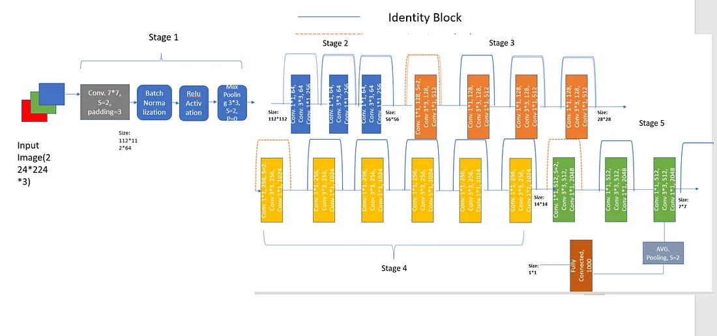
This produces a feature map with dimensions (56, 56, 64), which serves as the input to the subsequent convolutional blocks in the ResNet50 architecture.

Slide 66
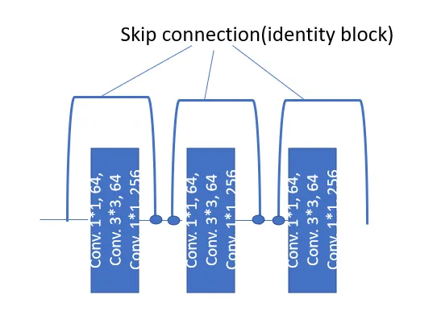

Stage 2:
The output of the first stage is forwarded to the first layer of convolution with 64 kernel filters and a size of 1*1 o/p of this feed to 3*3 convolution size with the same 64 kernel filters, o/p this feed to conv. 1*1 with 256 kernel filters.
Skip connection/ residual connection: the input(output from the max pool at stage 1) is passed with size of image 56*56 to relu activation before the next convolution layers.
In this uses 9 Layers of convolutional layer followed by batch normalization and relu activation.
The identity block(connecting blue color lines from one to another block of convolutions).

Slide 67


Stage 3:
In this, 12 layers of convolutional layer followed by batch normalization and relu activation are used.
Here Projection block used as the dimension of input and output is not the same, bypassing the first three layers convolutional layer, in the first layer convoluting with the size of kernel 1*1 with 128 filters (stride=2)to downsample the input and to change the depth of the input to match the output followed by convolution of 3*3, with, a same number of filters and conv.
1*1, kernel filters=512. Further use 9 layers of convolution with 1*1, filters=128=>3*3, filters=128 =>1*1, filters=512. The output of these 12th layers with size of image 28*28 forwards to relu activation before stage 4.

Slide 68

Stage4:
In this stage uses 18 layers of convolution each followed by batch normalization and relu activation function.
Output from relu activation has been forwarded to the first layer of the fourth stage where the dimension of image size is different so use projection block here in which input is forwarded to the convolution block to match the size of i/p with o/p at the second conv. block.
The rest of the process remains the same as like previous stage convoluting layer by layer to understand more deep features of the image.

Slide 69

Stage 5:
In this stage uses 9 layers of convolution each followed by batch normalization and relu activation function.
Output from relu activation has been forwarded to with size of image 14*14 the first layer of the 5th stage where the dimension of image size is different so use projection block here in which input is forwarded to the convolution block to match the size of i/p with o/p at the second conv. block.
The very first layer of the first convolutional block reducing the size of the image using 512 kernel filters with size of 1*1(stride=2) followed by conv 3*3 with 512 filters and conv. 1*1 with 2048 filters.

Slide 70

Finally, the output of the last relu activation unit at the fifth stage will be passed on to Average Pooling which reduces the spatial dimensions of the output tensor to a vector by applying global average pooling with stride size=2.
This operation computes the average of each feature map, resulting in a feature vector with the same number of channels as the number of filters in the last convolutional layer.

Slide 71
Defining convolutional block function
from tensorflow.keras.layers import Input, Conv2D, BatchNormalization, Activation, MaxPooling2D, Dense, GlobalAveragePooling2D, Add
from tensorflow.keras import Model
def conv_block(x, filters, kernel_size, strides, padding='same'):
x = Conv2D(filters=filters, kernel_size=kernel_size, strides=strides, padding=padding)(x)
x = BatchNormalization()(x)
x = Activation('relu')(x)
return x

Slide 72
Identity block and Projection block function:
def identity_block(x, filters):
shortcut = x
x = conv_block(x, filters=filters, kernel_size=(1, 1), strides=(1, 1))
x = conv_block(x, filters=filters, kernel_size=(3, 3), strides=(1, 1))
x = Conv2D(filters=filters * 4, kernel_size=(1, 1))(x)
x = BatchNormalization()(x)
x = Add()([x, shortcut])
x = Activation('relu')(x)
return x
def projection_block(x, filters, strides):
shortcut = x
x = conv_block(x, filters=filters, kernel_size=(1, 1), strides=strides)
x = conv_block(x, filters=filters, kernel_size=(3, 3), strides=(1, 1))
x = Conv2D(filters=filters * 4, kernel_size=(1, 1))(x)
x = BatchNormalization()(x)
shortcut = Conv2D(filters=filters * 4, kernel_size=(1, 1), strides=strides)(shortcut)
shortcut = BatchNormalization()(shortcut)
x = Add()([x, shortcut])
x = Activation('relu')(x)
return x
identity block used when the dimension of output and input are same

Slide 73
def ResNet50(input_shape=(224, 224, 3), num_classes=1000):
inputs = Input(shape=input_shape)
# initial conv layer
x = conv_block(inputs, filters=64, kernel_size=(7, 7), strides=(2, 2), padding='')
x = MaxPooling2D(pool_size=(3, 3), strides=(2, 2), padding='same')(x)
# conv block 1
x = projection_block(x, filters=64, strides=(1, 1))
x = identity_block(x, filters=64)
x = identity_block(x, filters=64)
# conv block 2
x = projection_block(x, filters=128, strides=(2, 2))
x = identity_block(x, filters=128)
x = identity_block(x, filters=128)
x = identity_block(x, filters=128)

Slide 74
# conv block 3
x = projection_block(x, filters=256, strides=(2, 2))
x = identity_block(x, filters=256)
x = identity_block(x, filters=256)
x = identity_block(x, filters=256)
x = identity_block(x, filters=256)
x = identity_block(x, filters=256)
# conv block 4
x = projection_block(x, filters=512, strides=(2, 2))
x = identity_block(x, filters=512)
x = identity_block(x, filters=512)
# global average pooling and dense layer
x = GlobalAveragePooling2D()(x)
outputs = Dense(num_classes, activation='softmax')(x)
model = Model(inputs=inputs, outputs=outputs)
return model

Slide 75
ResNet
In Python

Slide 76


Slide 77


Slide 78


Slide 79


Slide 80


Slide 81


